Slide 1
6420 Internet & Web Development
Week 2 Session 1

Slide 2
Storyboard
“The storyboard is an intermediate stage - concept and visualization…”

Slide 3
Storyboards
are graphic organizers in the form of illustrations or images displayed in sequence for the purpose of pre-visualizing a motion picture, animation, motion graphic or interactive media sequence.
A storyboard is a sketch of how to organize a story and a list of its contents

Slide 4
History of the storyboarding
It was developed by Walt Disney Productions during the early 1930s, after several years of similar processes being in use at Walt Disney and other animation studios.

Slide 5
Storyboard – where it can be used:
Film
Theatre
Animation
Multimedia
Games
Web development
Design Software Interfaces

Slide 6
Storyboard what to use?
Paper Or Screen?

Slide 7
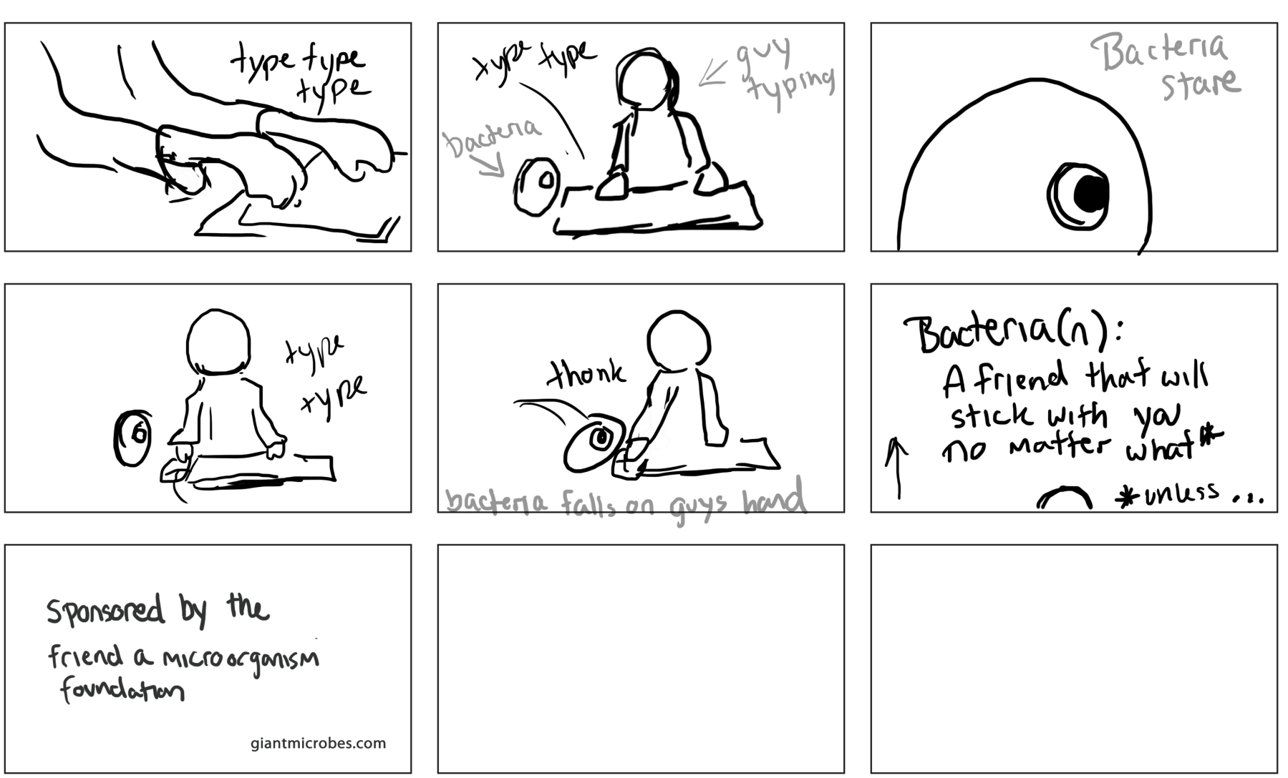
Example

Slide 8
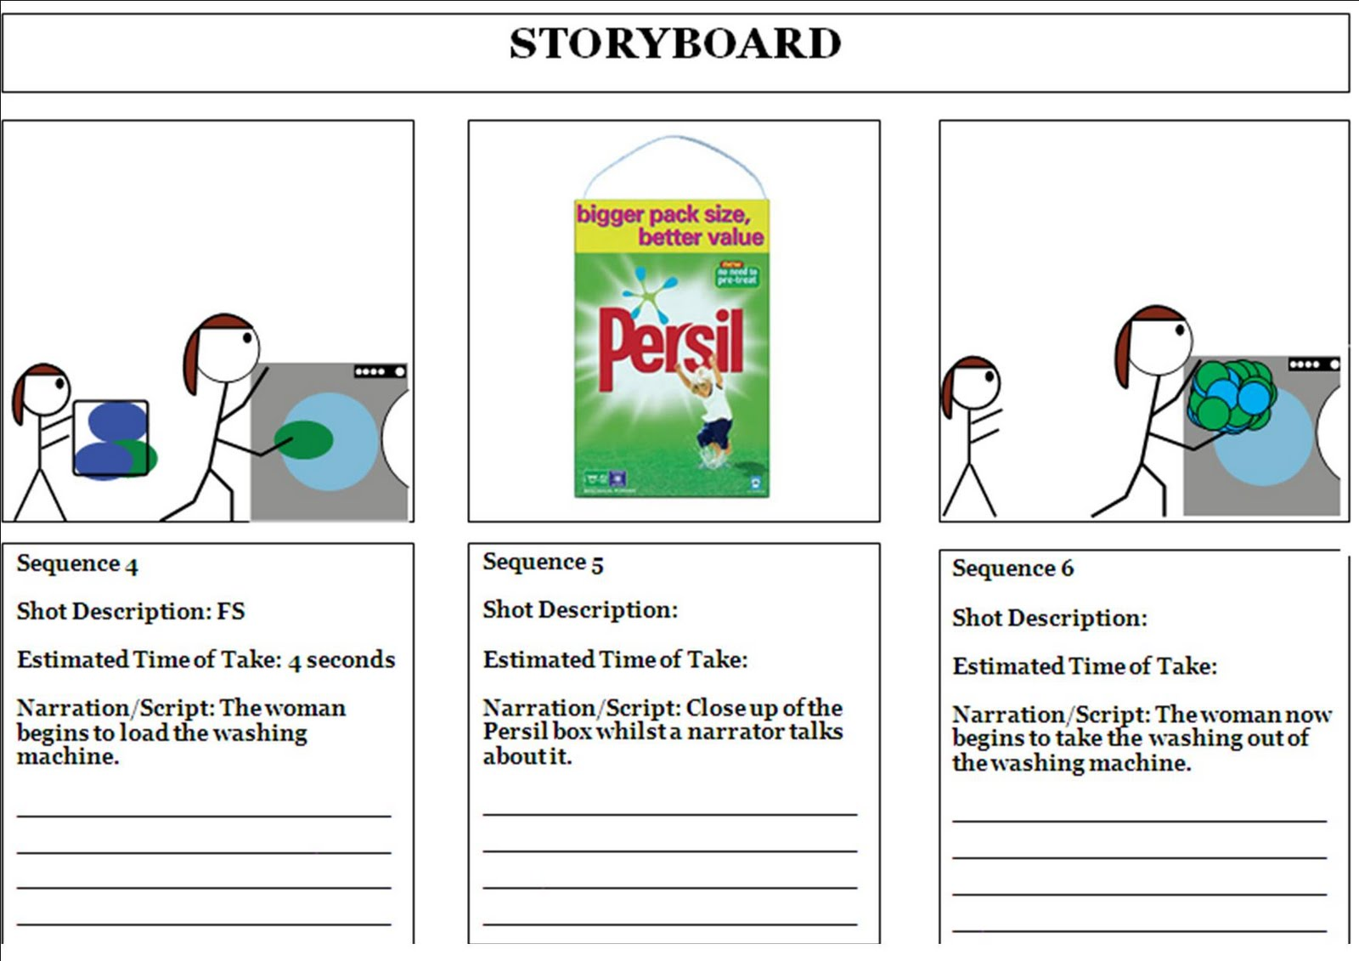
Example

Slide 9
We need Storyboard
to identify the specifications
to illustrate the important steps of the user experience.
to help the user understand exactly how the end product will work
to save time and resources, it is cheaper to make changes to a storyboard

Slide 10
Storyboard Elements
Every storyboard has elements - representation of actual elements of a finished presentation. These are in the form of text, video, sound, images and more...

Slide 11
Work with Elements
Decide what pieces of the story work best in video.
Decide what pieces of the story work best in still photos.
Does the audio work best with video, or will it be combined with still photos?
What part of the story works best in graphics?
Does the story need a map
What part of the story belongs in text?
Make sure the information in each medium is complementary, not redundant.
Interactivity means giving the reader both input and control in a story.

Slide 12
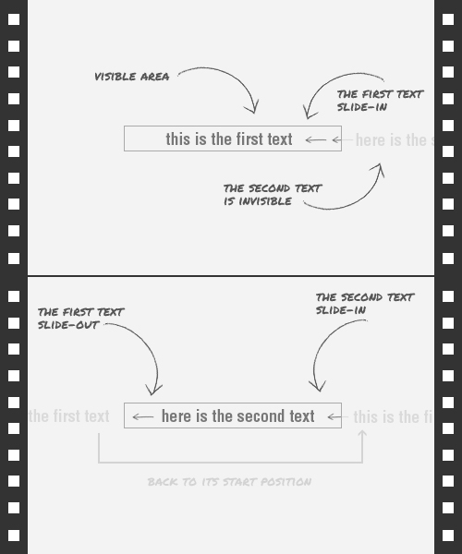

Slide 13
Information on storyboard for each frame:
Description
Name of elements(text, images, sounds, video, link)
Duration
Elements Animation (movement, expanding, fading, colour changing…)

Slide 14
Class Activity:
Create storyboard with 3 key frames
Implement your solution using CSS animation

Slide 15
References
http://www.presentationteam.com/presentation-tips/powerpoint-tips/presentation-storyboarding
http://multimedia.journalism.berkeley.edu/tutorials/starttofinish/storyboarding/
http://en.wikipedia.org/wiki/Storyboard
http://mpartogi.wordpress.com/2011/11/
http://jleagueproductions.blogspot.co.nz/2011/05/storyboard-1.html

